Slide 1


SAZ AUTOMOTIVE
FINAL PROJECT
BY MANOJ ADIKARI

Slide 2

Elevator Pitch
Who Am I -: Manoj Adikari
Goal -: To put all theories and practicals learnt during the journey of full stack developing in a one platform
Problem State -: 60% of automotive individuals time is spent on finding previous data
Aggravate it -: That might be why they’re struggling with enhancing their business to the next level
Solution -: Maintaining a system can help shorten the time spent on accessing all data
Add Value -: Enable to access all records and reports to make decisions anywhere anytime.

Slide 3
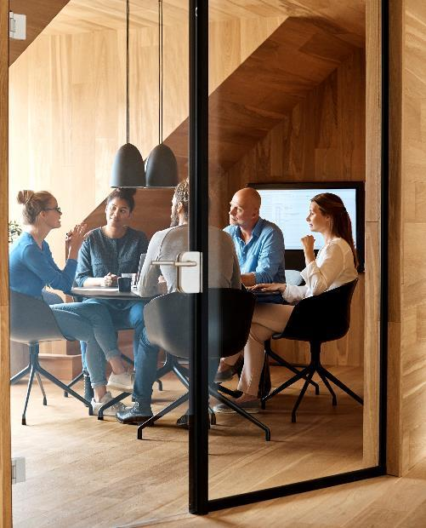



Description
The system includes 6 major processes related to individual automotive business. Firstly, purchasing vehicles secondly, do modifications thirdly, selling vehicles fourthly, renting vehicles, fifthly, do repairs and finally maintain services. All these records related to these business functions are stored in this system and generate reports to make decisions.

Slide 4



Motivation for development
There are several factors motivate me to develop this system. The major point is to use all the knowledge learnt during the course into action
Then the second factor is I am a vehicle lover. Who is planning to start an automotive business in future.
Third point is to by combining software development skills and passion to grow myself in a better living stand.

Slide 5
User Story
User 1 Administrator
When I load the system, using administration username and password able to log into the welcome page
Then navigate to the sidebar and can add an employee to the system
In the same system tool menu can create a user login for a specific user
Administrator can add system set up data

Slide 6
User Story
User 2 System User
User can edit user profile
User can add purchase vehicle details to the system
User can view stored vehicle data
User can add service data and repair data

Slide 7
Process

Slide 8
Technologies Used
Note JS
React Interface
MySql Server
CSS
Bootstrap
Graphql
Express.js
Java Script

Slide 9
Breakdown of tasks and roles
User login page
Welcome screen
Side menu bar
Add purchase vehicle page
View purchase vehicle page
Add employee page
Create user logins
MySql database develop
Solo work done by me (Manoj Adikari)

Slide 10
Challenges
Time management due to other commitments such as job
To develop front-end using react exceeded the time that expected
Had to explore new ideas due to using MySql database
Had issues when node application deploy to Heroku
Had difficulties using graphql with MySql server

Slide 11
Successes
Learned well to develop front-end using react
Ability of creating an interactive system
Had a greater experience in node js and MySql
Achieved a confident in working with bootstrap
Open to explore new ideas while searching for fixing errors

Slide 12
Directions for future development
Item | Description
Vehicle sales module | View, add, save, update, delete options with all features
Vehicle rental module | View, add, save,update, delete options with all features
Vehicle repairs module | View, add, save, update, delete options with all features
Vehicle general services modules | View, add, save, update, delete options with all features
Adding images | User profile and list of vehicles
Adding user permissions | Assign authentications for certain levels
Send notification | Send text message for rego expiration prior to expiring
Generate reports | Each module and income and expences

Slide 13
Links

Slide 14
Deployed
https://morning-peak-89979.herokuapp.com/

Slide 15
GitHub Repo
https://github.com/ManojAdikari/Saz_Automotive.git

Slide 16

Demo

Slide 17


Thank You

